Slide 1
Accessibility Suite of Knowledge
Catherine Watterson Norm Hodne Wendy Chisholm Jennifer Zhang

Slide 2

Microsoft accessibility and inclusion
Accessibility Program
Focus on Engineering
Culture Change
Investments
Tools & Sustainability
Engineering Best Practices

Slide 3
Accessibility program development Norm Hodne

Slide 4

Beginning is hard and unlike a chess game, the work doesn't stop.

Slide 5
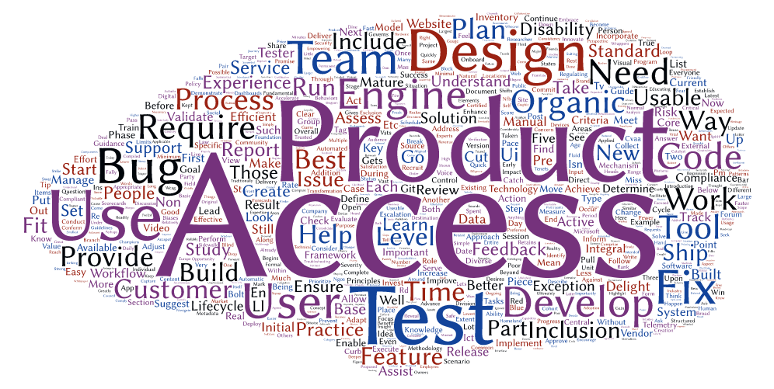
To be successful we need to focus on key elements

Slide 6

Example program elements
Strategy
Financials
Standards
Best Practices
Governance
Training
Procurement
Culture
Communications

Slide 7
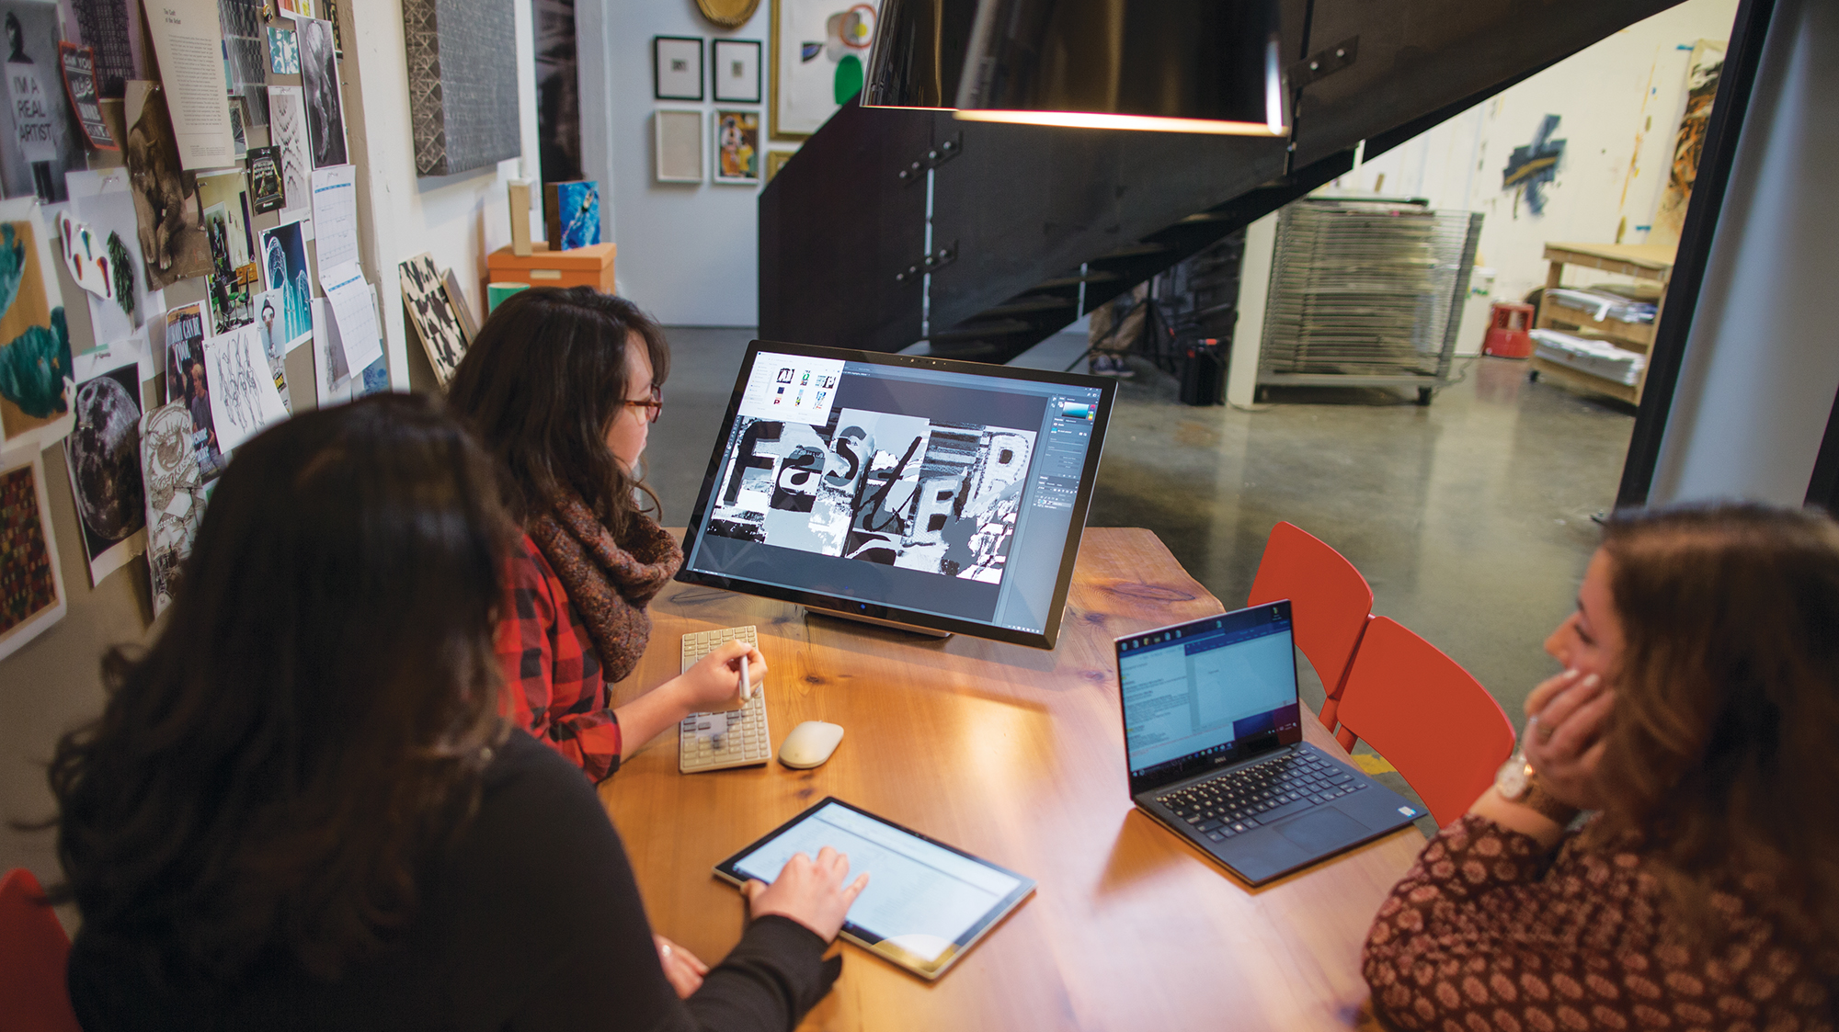
A diverse set of skills are needed for success

Slide 8
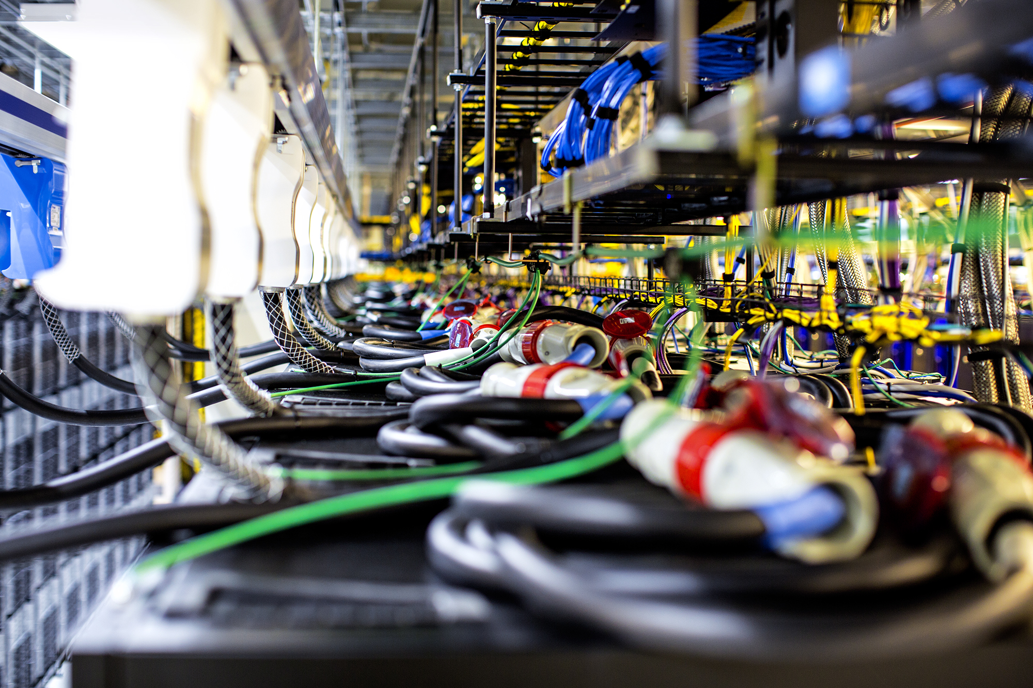
Engage early with product teams
Identify executive sponsor
Assign points-of-contact
Identify products and owners
Assess products
Create engineering plan
Train & mentor engineers

Slide 9

Firefighting heroes are welcome for a limited time.

Slide 10

Communicate, educate, inform, monitor, assess and report.

Slide 11

It's more complicated and takes longer than you first think.

Slide 12
Tooling Wendy Chisholm

Slide 13

Accessibility bugs
Overwhelming for developers
==
Barriers for customers

Slide 14
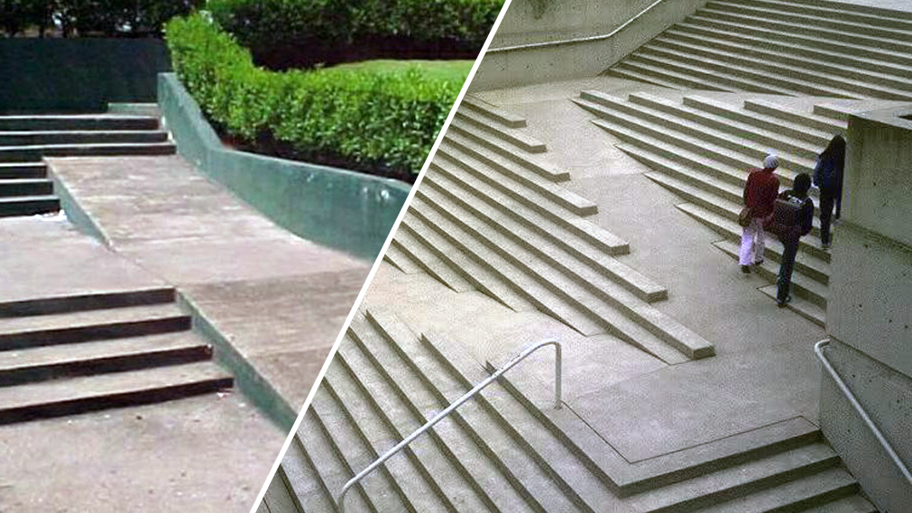
Bolt on vs Built in
Bolt on
Built in

Slide 15
1ES Accessibility Vision
Engineering Accessibility Vision
Integrate accessibility throughout​
Accessibility bugs​
Ideally: prevent them​
At a minimum: make it easier to find, fix, and file
Plan
Design
Code
Build &
Deploy
Test
Feedback
Requirements: prevent a11y blockers
Specs: ~70% of a11y issues are design related
FastPass: 2 steps, <5 minutes,
based on aXe
DevOps: integrate into the pipeline
Full assessments: assisted manual tests, suppliers
Listen: Customer walkthroughs, user
voice, eDAD, feedback

Slide 16
Engineering Accessibility Vision
Integrate accessibility throughout​
Accessibility bugs​
Ideally: prevent them​
At a minimum: make it easier to find, fix, and file
Plan
Design
Code
Build &
Deploy
Test
Feedback
Requirements: prevent a11y blockers
Specs: ~70% of a11y issues are design related
FastPass: Catch ~25% of issues in <5 minutes
DevOps: integrate into the pipeline
Full assessments: assisted manual tests, suppliers
Listen: Customer walkthroughs, user
voice, eDAD, feedback

Slide 17
Engineering best practices Jennifer Zhang

Slide 18
Engineering Accessibility Vision − Shift Left
Integrate accessibility throughout​
Accessibility bugs​
Ideally: prevent them​
At a minimum: make it easier to find, fix, and file
Plan
Design
Code
Build &
Deploy
Test
Feedback
Requirements: prevent a11y blockers
Specs: ~70% of a11y issues are design related
FastPass: Catch ~25% of issues in <5 minutes
DevOps: integrate into the pipeline
Full assessments: assisted manual tests, suppliers
Listen: Customer walkthroughs, user
voice, eDAD, feedback

Slide 19


Roles and Responsibilities

Slide 20


Hands on Training Methods

Slide 21
Microsoft accessibility and inclusion
Accessibility Program
Focus on Engineering
Culture Change
Investments
Tools & Sustainability
Engineering Best Practices

Slide 22
Resource Links
Microsoft at CSUN
Aka.ms/CSUN2018
Answer Desk for Accessibility Support
aka.ms/DAD
Microsoft Accessibility Overview
Microsoft.com/Accessibility

Slide 23
We want to hear from you.
Connect with us in person today or anytime through our support and feedback channels.
Disability Answer Desk for phone/chat/ASL Help: Aka.ms/AccessibilitySupport
User voice Forum for Accessibility Feedback: Aka.ms/AccessibilityFeedback

